Slide 1
USING STREAM MODULE TO STREAM DATA
22H51A05B7
P ANAGHA SRI MEGHANA

Slide 2
UNDERSTANDING THE STREAM MODULE:
Node.js provides a powerful streaming API via the stream module, which allows you to handle data in chunks rather than loading it all into memory at once. This is especially useful for processing large files or network responses efficiently. Streams in Node.js are objects that enable you to read data from a source or write data to a destination in a continuous flow. Instead of processing the entire dataset at once, streams work with chunks of data, which allows for efficient handling of large datasets and real-time processing.
Types of streams:
Readable Streams: These are streams that provide data that can be read. Examples include file streams, HTTP request streams, and process input streams.
Writable Streams: These are streams where data can be written. Examples include file streams and HTTP response streams.
Transform Streams: These are streams that modify or transform the data as it is read from the source and written to the destination. They are both readable and writable.
Duplex Streams: These streams are both readable and writable.

Slide 3
CORE CONCEPTS:
Chunks: Streams work with data in chunks, which are small pieces of data that are read from or written to the stream sequentially. This is different from dealing with data in large blocks.
Backpressure: Streams handle backpressure automatically. If a writable stream cannot handle the speed at which data is being written, it will signal the source to slow down. This prevents overwhelming the destination with too much data at once.
Pipes: The pipe method connects a readable stream to a writable stream, allowing data to flow seamlessly from one to the other. This is a fundamental operation in stream processing.

Slide 4
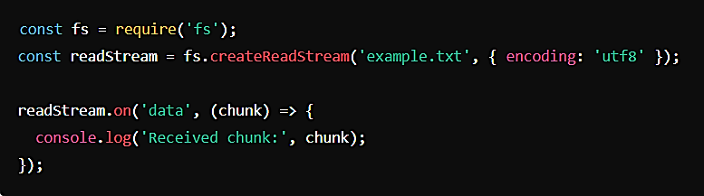
1. Readable Streams
A Readable Stream is a type of stream that provides data that can be read from. These streams emit data in chunks, and consumers can read this data piece by piece.
Examples:
File Streams: Reading data from files using fs.createReadStream.
HTTP Request Streams: The request object in an HTTP server or client request (http.IncomingMessage).
Process Input Streams: Reading input from the standard input (process.stdin).
Common Methods:
stream.read(): Reads data from the stream.
stream.pipe(destination): Pipes data from the readable stream to a writablestream.
stream.on('data', callback): Listens for data events emitted by the stream.

Slide 5
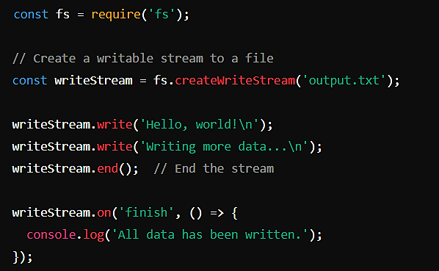
2. Writable Streams
A Writable Stream is a type of stream that allows you to write data to it. These streams accept data that can be written to a destination.
Examples:
File Streams: Writing data to files using fs.createWriteStream.
HTTP Response Streams: The response object in an HTTP server (e.g., http.ServerResponse).
Process Output Streams: Writing output to the standard output (e.g., process.stdout).
Common Methods:
stream.write(chunk, encoding, callback): Writes a
chunk of data to the stream. encoding specifies the
character encoding, and callback is called when the
data has been written.
stream.end(chunk, encoding, callback): Ends the
writable stream, optionally writing a final chunk of
data. This triggers
the finish event.
stream.on('finish', callback): Listens for the
finish event, emitted when all data has been flushed
to the destination.

Slide 6
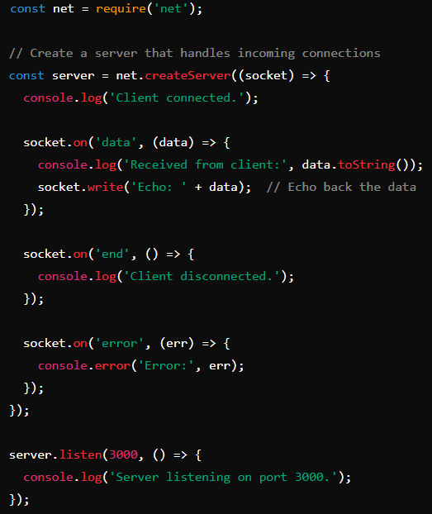
3. Duplex Streams
A Duplex Stream is a type of stream that can both read from and write to. These streams allow for bidirectional data flow.
Examples:
TCP Sockets: The socket object in a TCP server (e.g., net.Socket).
Transform Streams: While primarily for transformation, they can also act as duplex streams since they are both readable and writable.
Common Methods:
stream.read(size): Reads data from the stream.
stream.write(chunk, encoding, callback): Writes data to the stream.
stream.pipe(destination): Pipes data from the duplex stream to another stream, typically a writable stream.

Slide 7
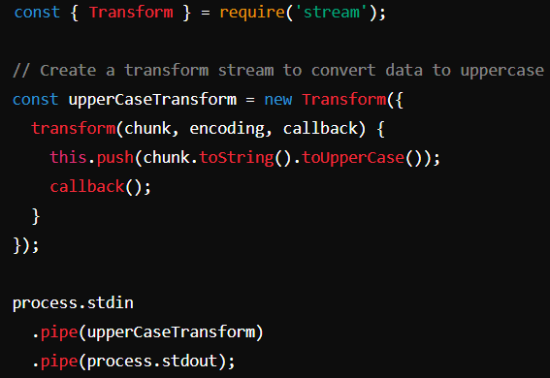
4. Transform Streams
A Transform Stream is a special type of duplex stream that can modify or transform data as it is being read and written.
Examples:
Compression Streams: Using zlib.createGzip() or zlib.createGunzip() for data compression.
Data Conversion: Custom streams that modify data, like converting text to uppercase.
Common Methods:
stream._transform(chunk, enzcoding, callback):
The core method that transforms the data chunk.
It is called internally when data is written to the
stream.
stream._flush(callback): Called when the
stream ends to perform any final transformations.
stream.pipe(destination): Pipes the transformed
data to another stream, typically a writable stream.

Slide 8
CONCLUSION
Streams are a powerful abstraction in Node.js that provide a robust mechanism for handling data efficiently and effectively. By leveraging streams, developers can:
Handle Large Volumes of Data: Process data incrementally without consuming excessive memory.
Enhance Application Performance: Ensure smooth and efficient data processing with automatic backpressure management and non-blocking operations.
Build Scalable Systems: Create applications that can handle high loads and real-time data processing demands.
Promote Code Reusability: Use composable and modular stream components to build complex data processing pipelines.
In summary, streams are a foundational concept in Node.js that enable efficient data handling, real-time processing, and scalable application design. Understanding and using streams effectively is essential for developing high-performance, data-intensive applications in Node.js.

Slide 9
“THANK YOU”

